Slide 1
CHEM 570, Fall 2017
Concepts in Chemical Biology
Lecture 18b
Phage display and yeast hybrid systems

Slide 2
Tools for investigating protein-protein interactions
Key questions:
1. How can new protein-protein interactions be discovered?
2. How can we rapidly identify a peptide ligand for a protein?
3. How can we study the interaction of two proteins in vivo?
Notes:
More broadly than direct affinity-based methods, but with less initial information

Slide 3
Selection approach (not screening)
Generate large pool of proteins
Pass over support-bound
compound/protein/etc.
iterate
(repeat)
Wash, then elute binders
How can this be done when there is no
direct way to amplify proteins?

Slide 4
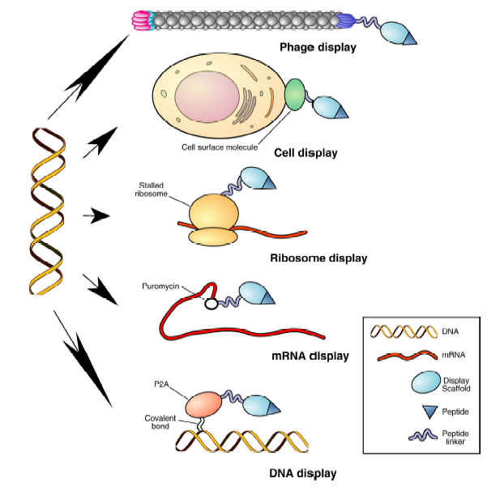
Enabling selection of proteins
Physically link the protein to the DNA/RNA that encodes it
“Display
technologies”
Sergeeva et al., Adv. Drug Deliv. Rev. 2006, 58, 1622

Slide 5
Phage display
Bacteriophages: viruses that infect bacteria
After infection, bacteriophages take over the bacterial machinery, replicate, and then...
(a) lyse the bacteria (lytic phage)
or (b) are secreted by the bacteria (non-lytic phage)
Phage display takes advantage of infection/replication properties of phage
to “display” essentially any protein on the
phage surface
Two main types of phage are commonly used:
• M13 phage
• T7 phage
Pande et al., Biotechnol. Adv. 2010, 28, 849
Zani & Moreau, Biochimie 2010, 92, 1689
Bratkovic, Cell Mol. Life Sci. 2010, 67, 749

Slide 6
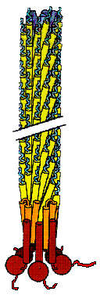
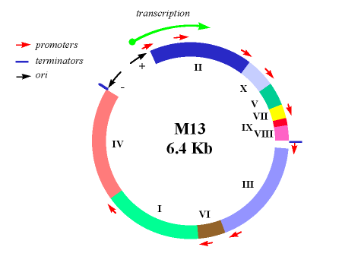
M13 phage for phage display
• “filamentous”: 6.5 nm diameter, 930 nm long
• single-stranded circular DNA genome, ~6.4 kb
• 10 genes in genome
• non-lytic
2700 copies
of pVIII
(50 aa coat
protein)
5 copies of pIII
(50 aa “pilot”
protein)
Fuse gene for protein of interest to gene for pIII,
and the resulting protein will be “displayed”
on the surface of the bacteriophage
5’
gene for protein of interest
gene for pIII
3’
Notes:
Or gene for POI can be on 3'-end of pIII gene (example upcoming)

Slide 7
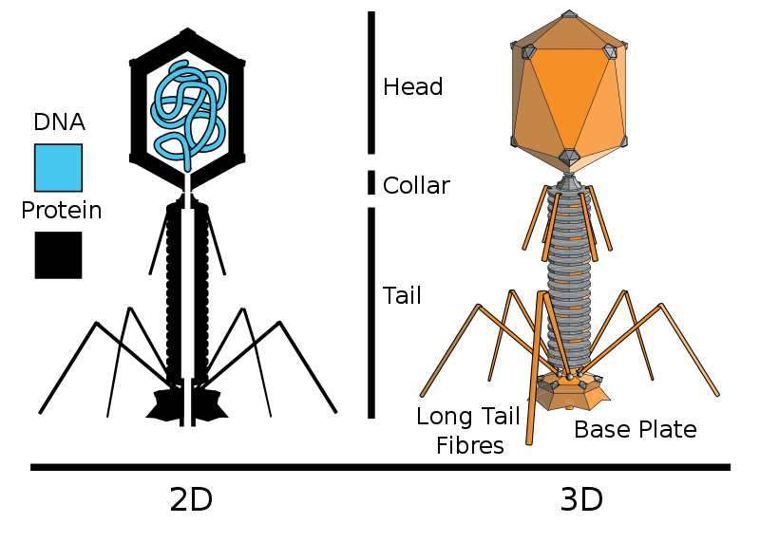
T7 phage for phage display
• one of the most primitive forms of life
• double-stranded linear DNA genome, ~40 kbp
• 56 genes in genome
• lytic
415 copies
of coat protein 10
(cp10, 50 aa coat
protein)
5’
gene for cp10
gene for protein of interest
3’
Notes:
Google image search "T7 bacteriophagee" - electron micrograph images

Slide 8
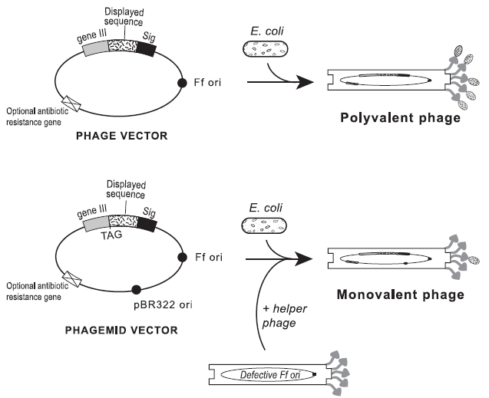
Phage display: cloning
(lacks certain
structural genes)
(provides most structural proteins required to generate complete phage particles)
Zani & Moreau, Biochimie 2010, 92, 1689

Slide 9
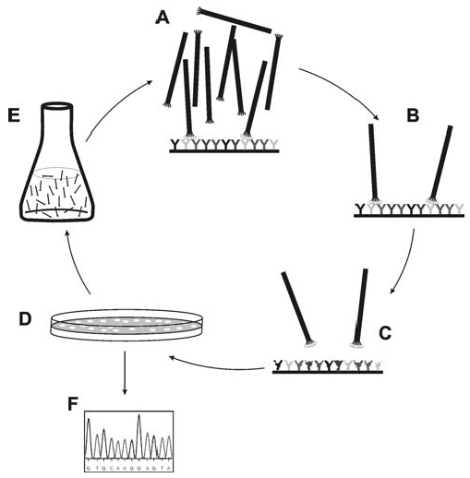
Phage display: panning
incubate over immobilized target
amplify bacteria
and collect
phage
wash away non-binding phage
plate eluted phage on host bacteria
elute target-binding phage
sequence phage DNA → identity of displayed ligand
Bratkovic, Cell Mol. Life Sci. 2010, 67, 749

Slide 10
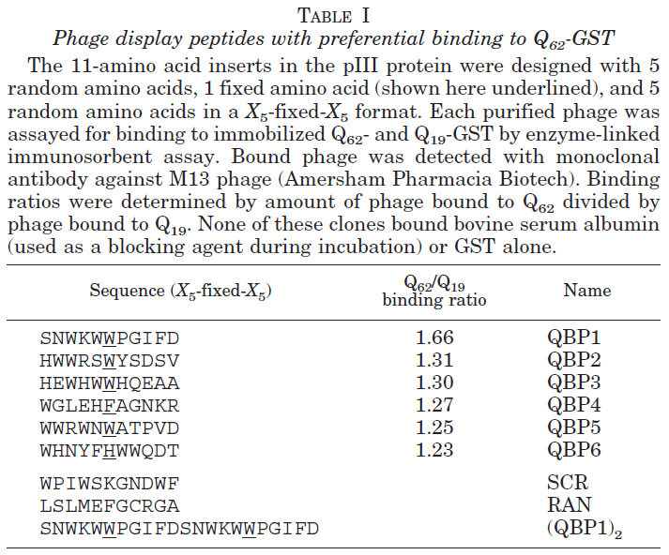
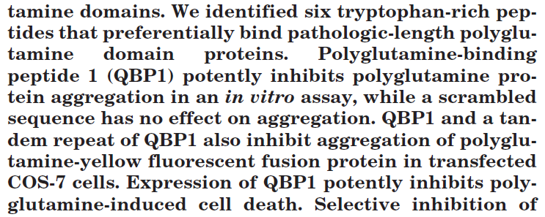
Example of phage display
Searching for inhibitors of polyglutamine aggregation:
potential implications for Huntington’s Disease (HD)
33 nt sequence ligated to 5’-terminus of M13 pIII gene
→ 11 aa peptide library (6th position fixed as W)
Q₆₂ = pathological length;
Q₁₉ = normal length
Selective inhibition of pathological poly-Q interactions may be a useful therapeutic strategy
Nagai et al., J. Biol. Chem. 2000, 275, 10437

Slide 11
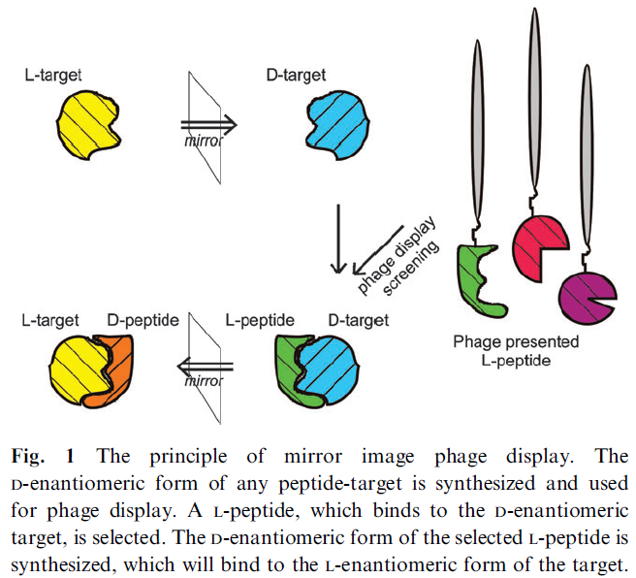
Mirror-image phage display
Funke & Willbold, Mol. BioSyst. 2009, 5, 783 (review)

Slide 12
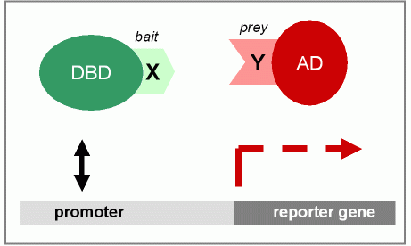
Identification of protein-protein interactions:
Two-hybrid systems
Recall (Slide 2-29): Transcription factors have separate DNA-binding domains (DBD) and activation domains (AD)
“Bait” and “prey” are terms used in two-hybrid systems

Slide 13
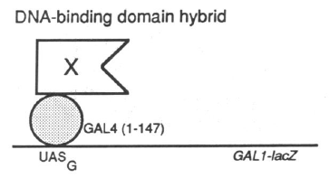
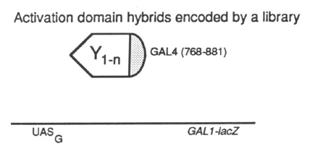
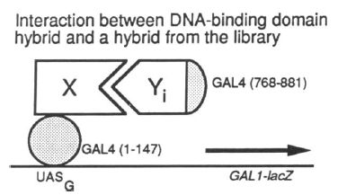
The two-hybrid system
Chien et al., Proc. Natl. Acad. Sci. USA 1991, 88, 9578

Slide 14
Broad utility of yeast n-hybrid systems
DNA-protein
protein-protein
Forward: transcriptional activation of a gene required for growth
Reverse: dissociation of interaction that otherwise activates expression of toxic gene
Vidal & Legrain, Nucleic Acids Res. 1999, 27, 919

Slide 15
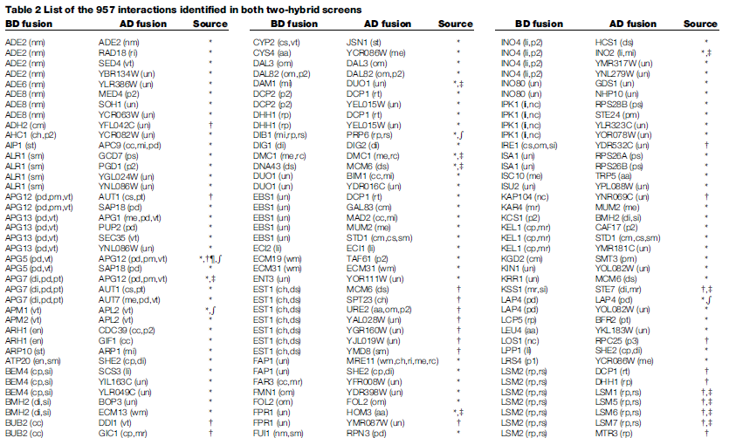
Comprehensive identification of
protein-protein interactions
Seeking to identify every yeast (S. cerevisiae)
protein-protein interaction
• 6000 ORF-AD fusions screened against 192 yeast proteins
• 6000 ORF-DBD fusions screened against 6000 ORF-AD fusions
• Detection of 957 putative interactions involving 1004 proteins
(957 entries
in this table...!)
Uetz et al., Nature 2000, 403, 623
Notes:
Subsequently, various papers on “yeast interactome”
Yeast interactome website and database: http://interactome.dfci.harvard.edu/S_cerevisiae/

Slide 16
Three-hybrid systems
RNA-based three-hybrid system: study interactions between RNA (X) and proteins (Y)
DB
RBP
RNA
X
?
Y
AD
(known)
(known)
Small-molecule-based three-hybrid system: study interactions between small molecules (X) and proteins (Y)
DB
LBP
ligand
X
?
Y
AD
(known)
(known)
Vidal & Legrain, Nucleic Acids Res. 1999, 27, 919

Slide 17
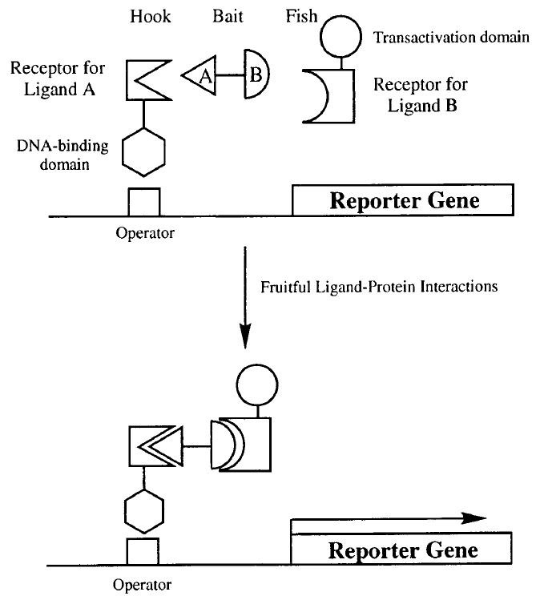
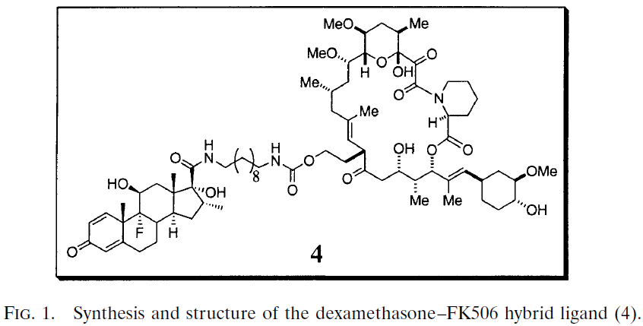
First report of a three-hybrid system
GCR
FKBP12
binds to
glucocorticoid
receptor
binds to
FKBP12
GCR
FKBP12
• Discover new receptors for small-molecule ligands
• Screen for new small-molecule ligands for known receptors
Licitra & Liu, Proc. Natl. Acad. Sci. USA 1996, 93, 12817
Notes:
Would be SCREEN (not selection) for new small-molecule ligands for known receptors

