Slide 1
CHEM 570, Fall 2017
Concepts in Chemical Biology
Lecture 11
Identifying biological targets
of small-molecule compounds
by affinity chromatography

Slide 2
Why do we want to identify the biological target of a compound?
1. To understand mode of action
• Often required for FDA approval
• Predict or explain toxicity and other features
2. To allow design of more potent variants
• Enable structure-based design
• Enhance favorable features; reduce unfavorable
3. To learn about fundamental biology
• Biological pathways involving target can be probed
• New biological processes can be discovered

Slide 3



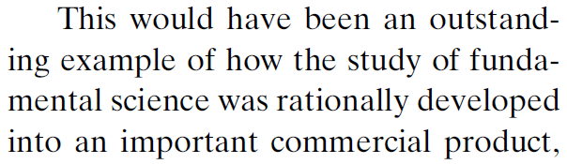

Lyrica
(S)-(+)-3-isobutyl-GABA
[GABA = γ-aminobutyric acid]
Treatment for fibromyalgia (neuropathic pain)
$1.2 billion of sales in first full year (2006)
Silverman Hall
Northwestern University
Opened 2010
Cost: $100 million
R. Silverman, Angew. Chem. Int. Ed. 2008, 47, 3500
Notes:
GAD = L-glutamic acid decarboxylase (Glu -> GABA)

Slide 4
How many drug targets are there?
There are 1,357 unique FDA-approved drugs
1,204 small-molecule
166 biological
Protein targets have been identified for 1,065 of these
These 1,065 drugs have 324 distinct molecular targets
248 protein targets of small molecules,
76 protein targets of biologicals
Overington et al., Nat. Rev. Drug Discov. 2006, 5, 993

Slide 5

How many drug targets are there?
Of the 324 known protein targets (of any drugs),
266 are in the human genome
Of the 248 known protein targets (of small molecules),
207 are in the human genome
There are ~30,000 human genes
With splice variants and PTMs, there are ~1,000,000 human proteins!
Overington et al., Nat. Rev. Drug Discov. 2006, 5, 993

Slide 6
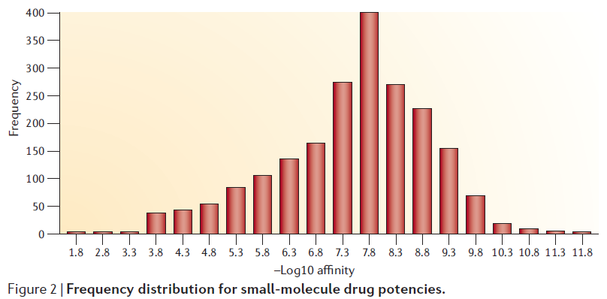
Characterization of known drugs and targets
Median potency of small-molecule
drug-receptor target pairs is ~20 nM
10^{–7.8} = 16 nM
(“potency” = IC₅₀, EC₅₀, K_{i}, K_{d}, etc.)
50% of drugs target just four gene classes:
GPCRs (G-protein-coupled receptors), nuclear receptors,
ligand-gated ion channels, voltage-gated ion channels
Overington et al., Nat. Rev. Drug Discov. 2006, 5, 993

Slide 7
More about drug targets
1,620 distinct proteins are directly linked to a human disease, but only 105 of these proteins are current drug targets
Are pharmaceutical companies
actively seeking new drug targets?
361 new molecular entities (NME) were approved by the
FDA between 1989 and 2000:
• 76% hit already “drugged” protein targets
• 6% target a previously “undrugged” protein/domain!
• 4% have unknown targets
• 17% believed not to have distinct molecular target
“The most fruitful basis for the discovery of a new drug
is to start with an old drug”
Overington et al., Nat. Rev. Drug Discov. 2006, 5, 993

Slide 8
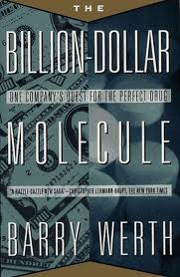
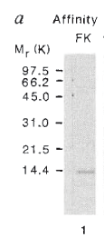
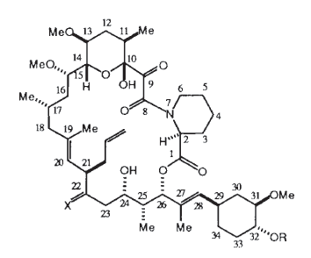

Classic target ID success story #1
FK506: a potent immunosuppressant compound
• Attached to agarose support
• Added human spleen extract
• Eluted with free FK506 to displace bound protein target
FKBP12 is an abundant (mM) protein
K_{d} for FK506 / FKBP12 is <1 nM
FK506 is sold as Tacrolimus
See also The Billion Dollar Molecule
bovine
thymus
FKBP12
human
spleen
Harding et al., Nature 1989, 341, 758
Notes:
FKBP is a cis-trans proline isomerase
rapamycin also = macrolide immunosuppressant; found on Easter Island (Rapa Nui)

Slide 9
Classic target ID success story #2
Trapoxin and trichostatin were known to induce cell
cycle arrest and inhibit the deacetylation of histones
However, a histone deacetylase enzyme
had never been isolated!
Taunton et al., Science 1996, 272, 408; J. Am. Chem. Soc. 1996, 118, 10412

Slide 10
Classic target ID success story #2
A resin-bound version of trapoxin was synthesized, and bound proteins were eluted with boiling 1% SDS
protected Lys
in place of native Phe
Note that inclusion of free trapoxin → protein bands disappear; proteins not retained on resin
Taunton et al., Science 1996, 272, 408; J. Am. Chem. Soc. 1996, 118, 10412
Notes:
Why can’t use free trapoxin to elute bound proteins? (Note epoxide group)

Slide 11
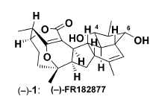
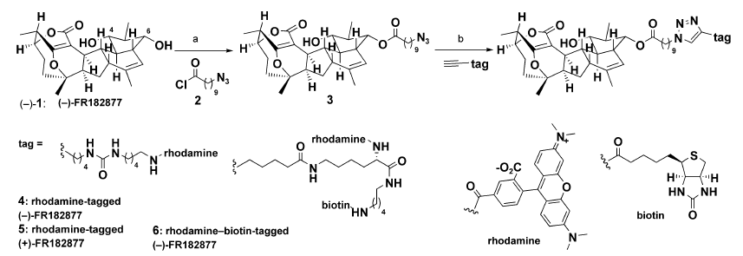
(–)-FR182877: Biological activity
Cell cycle arrest in cell lines;
anti-tumor effects in mouse models
Two potentially electrophilic sites
(+)-enantiomer is inactive
Synthesis of reporter-tagged variants
Adam et al., Angew. Chem. Int. Ed. 2003, 42, 5480
Notes:
FR compound is a natural product, isolated from a natural source and found to have antibiotic activity

Slide 12
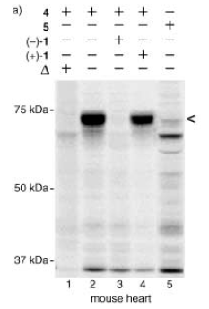
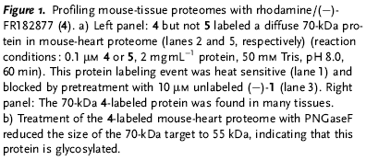
(–)-FR182877: Use of fluorescent variant
Fluorescently labeled variant was incubated with mouse heart lysates
Fl-(–)-1
Fl-(+)-1
• Only (–)-enantiomer binds to protein target
• Pretreatment with (–)-enantiomer blocks binding
• Heat-denaturing proteome blocks binding
• Other targets (e.g., 35 kDa band) correspond to nonspecific binding
Adam et al., Angew. Chem. Int. Ed. 2003, 42, 5480

Slide 13
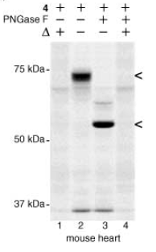
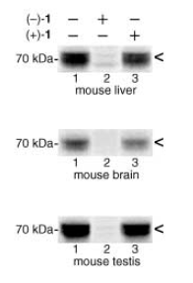
(–)-FR182877: Use of fluorescent variant
Target protein is found in other mouse organs as well
Target protein
is glycosylated
Adam et al., Angew. Chem. Int. Ed. 2003, 42, 5480

Slide 14
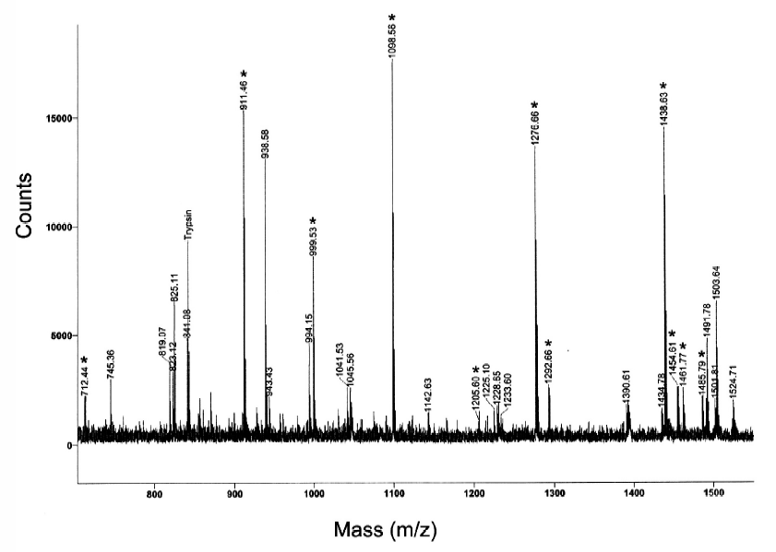
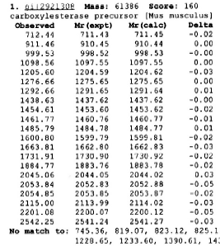
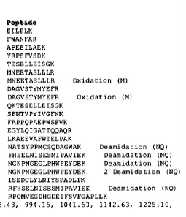
(–)-FR182877: Identification of target protein
Protein target isolated using dually labeled
(biotin + rhodamine) variant: avidin chromatography then
SDS-PAGE using fluorescence to identify band.
Protein target excised from gel, digested with trypsin,
and identified by mass spectrometry as
carboxylesterase-1 (CE-1)
Adam et al., Angew. Chem. Int. Ed. 2003, 42, 5480

Slide 15
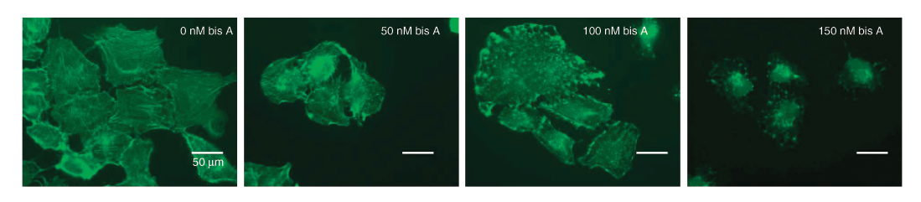
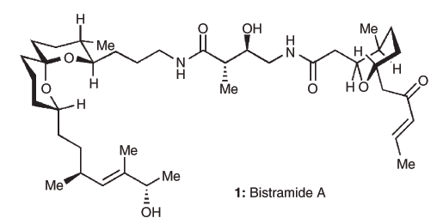
Bistramide A: Biological activity
Microscopy data: cells treated with bistramide A have duplicated their DNA but are stuck in cytokinesis
(final stage of mitosis)
IC₅₀ = 20–45 nM in cancer cell lines
Actin and myosin filaments form new rings around cells;
these rings are disrupted by bistramide A treatment
Statsuk et al., Nat. Chem. Biol. 2005, 1, 383

Slide 16
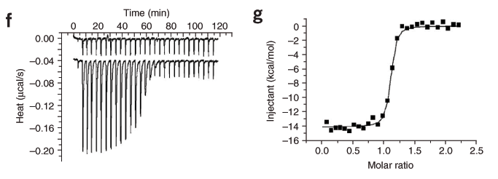
Bistramide A binds actin in vitro
ITC experiments:
K_{d} = 7 nM
1:1 stoichiometry
Binding presumably sequesters monomeric actin,
inhibiting actin polymerization and depolymerizing
filamentous actin both in vitro and in living cells
Statsuk et al., Nat. Chem. Biol. 2005, 1, 383

Slide 17
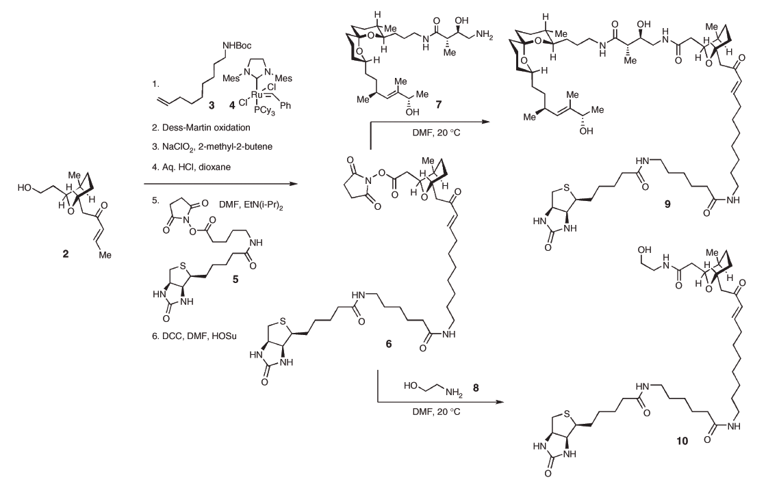
Synthesis of biotinylated bistramide A
NHS ester
(inactive control)
Statsuk et al., Nat. Chem. Biol. 2005, 1, 383

Slide 18
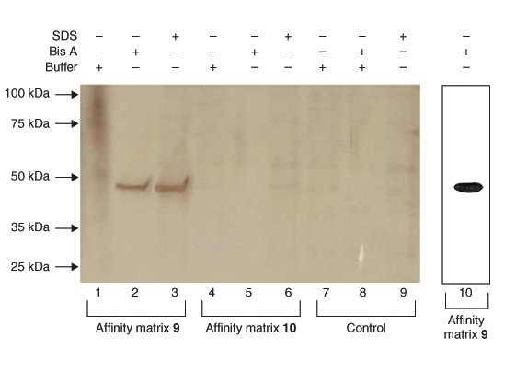
Biotinylated bistramide A pulls down actin
• Biotin-bistramide A preincubated with SA beads
• Beads incubated with cancer cell lysate and washed
• Beads eluted with free bistramide A or just 0.1% SDS
(either should be able to elute bound protein)
Actin selectively pulled down:
Western blot with
antibody to actin
silver-stained gel
Statsuk et al., Nat. Chem. Biol. 2005, 1, 383
Notes:
Could block binding with free bistramide A (expt not shown here)

Slide 19
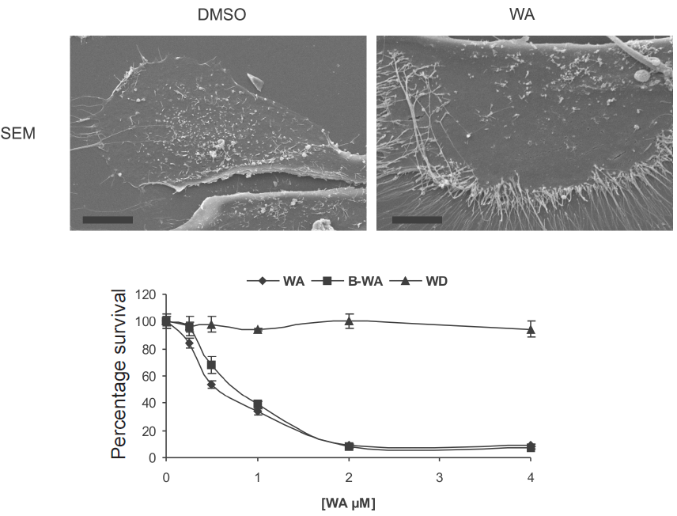
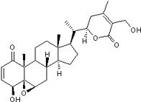
Withaferin A: Biological activity
Withaferin A (WA): effects on cell morphology and viability
• Unusual cytoplasmic projections (MCF-10A cells)
• Anticancer activity (CHP-100 cells)
Withaferin A
(WA)
WA = withaferin A
B-WA = biotin-withanferin A
WD = withanolide D
Falsey et al., Nat. Chem. Biol. 2006, 2, 33
Notes:
See Falsey paper for WD structure - close analogue of WA (HO at C20 [next slide], no HO at C27), but noncytotoxic
biotin is at C27 (far-right CH2OH, using pentafluorophenyl biotin) - see rxn next slide

Slide 20
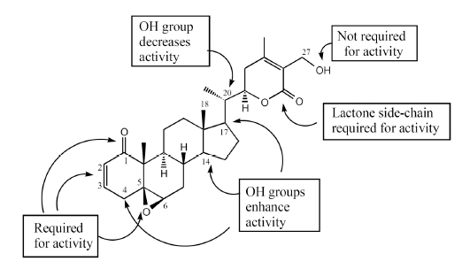
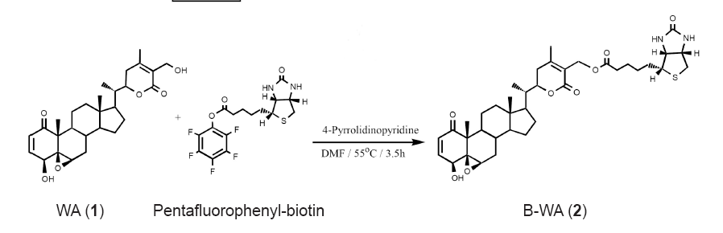
Withaferin A: SAR and biotinylation
Falsey et al., Nat. Chem. Biol. 2006, 2, 33

Slide 21
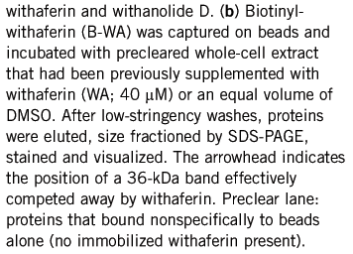
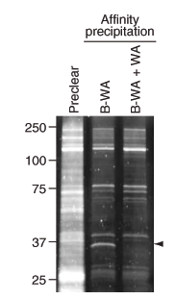
Withaferin A: Identification of target
Multiple proteins bind non-specifically,
but only one band is not present when
resin is incubated in presence of
free withaferin A
SYPRO Ruby
staining
Absent band is the putative target!
Falsey et al., Nat. Chem. Biol. 2006, 2, 33

Slide 22
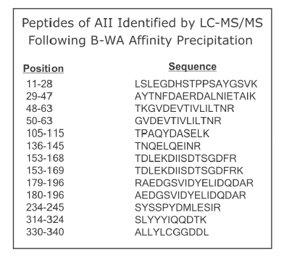
Withaferin A: Identification of target
Protein target excised from gel, digested with trypsin,
and identified by LC-MS/MS
10 noncontinuous peptide fragments detected,
covering 42% of protein
Sequence corresponds
to human protein
Annexin II
(molecular modeling of binding interaction – see manuscript)
Falsey et al., Nat. Chem. Biol. 2006, 2, 33

Slide 23
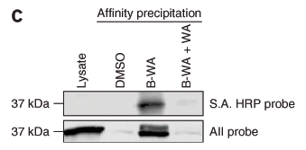
Withaferin A binds covalently to annexin II
1. Incubation of biotinylated-WA with lysate;
proteins run on SDS-PAGE gel and probed for biotin
2. Incubation of biotinylated-WA with lysate; proteins captured on streptavidin resin, eluted, and analyzed by western blot for annexin II
streptavidin probe
annexin II antibody
Falsey et al., Nat. Chem. Biol. 2006, 2, 33

Slide 24
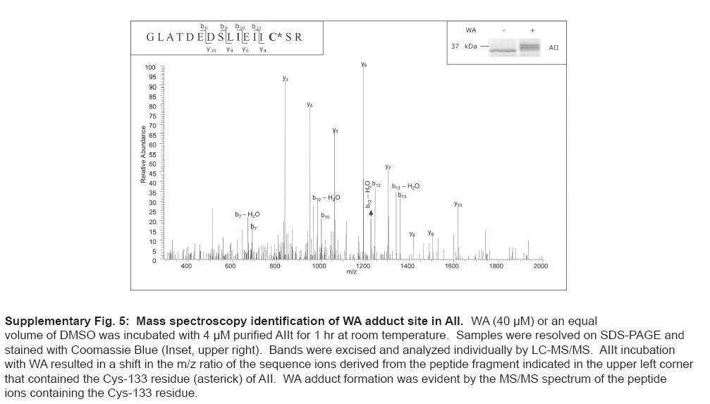
Withaferin A binds covalently to annexin II
Mass of annexin II increases by 470 Da
after treatment with withaferin A (MW = 470)
Cys133 adds at C3
(per molecular modeling)
Falsey et al., Nat. Chem. Biol. 2006, 2, 33

Slide 25
Exploring biological mode of action of WA
Does WA kill cells by binding to annexin II?
• Annexin II normally leads to F-actin bundling
• WA occupies site on annexin II where actin binds
• WA shown to disrupt actin cytoskeleton
Annexin II knockdown with RNAi was unsuccessful,
“presumably due to the relative abundance
and stability of the protein”
Transient increase in annexin II levels
increases the sensitivity of cells to WA (?)
Although full biology is not yet understood, annexin II
has been identified as a promising therapeutic target
Falsey et al., Nat. Chem. Biol. 2006, 2, 33

Slide 26
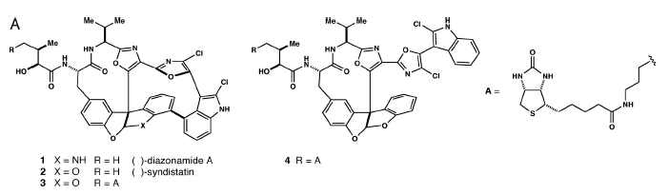
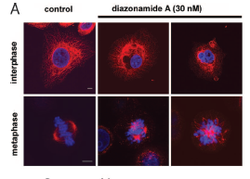
Diazonamide A: Biological activity
(inactive
control)
biotin
At low concentrations, induces arrest at G₂/M transition of cell cycle
(common for tubulin ligands; important for mitotic spindle)
red = antibody against α-tubulin = spindles
blue = stain for DNA (DAPI) = nucleus
No evidence for interaction with tubulin. Diazonamide-treated mice have no side effects observed with tubulin binders.
Wang et al., Proc. Natl. Acad. Sci. USA 2007, 104, 2068
Notes:
G1, S, G2, M

Slide 27
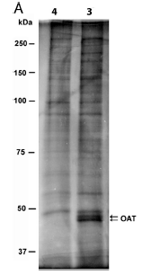

Biological target of diazonamide A is OAT
OAT = ornithine δ-amino transferase
SDS-PAGE of pull-down
Western blot
of pull-down
(reason for two bands
uncertain)
Wang et al., Proc. Natl. Acad. Sci. USA 2007, 104, 2068

Slide 28
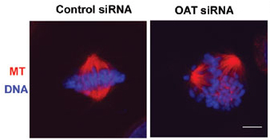
Confirmation of diazonamide/OAT via siRNA
OAT levels knocked down using siRNA in HeLa cells
Outcome: Massive cell death after 3 days, with mitotic spindle defects similar to diazonamide A treatment
OAT was not previously known to be involved in mitosis, nor was it a drug target
Wang et al., Proc. Natl. Acad. Sci. USA 2007, 104, 2068

Slide 29
Summary:
Lessons learned from such investigations
• Need high affinity (K_{d} < 200 nM) of compound for its target
• Covalent adducts are much easier to isolate
• Must use an inactive control compound
• Suitable follow-up studies are required to validate that the pulled-down protein is really the compound’s target
These important experiments can lead both
to new biology and to new medicinal targets

